Slide 1
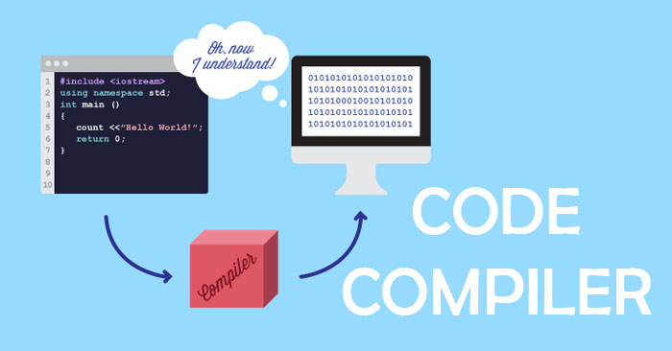
Types Of Compiler

Slide 2
Presented By
Md. Rabi Ul Alam Chowdhury Id : 011 151 066
Nasir Uddin Ahmed
Id : 011 151 086

Slide 3
Compiler
A program that converts language
Compiler classification can be done in some category
According to passing
a. Single Pass Compiler
b. Two Pass Compiler
c. Multipass Compiler

Slide 4
Single Pass Compiler
Passes through the parts once
Source code directly transforms into machine code
Source Code ---→ Compiler ------→ Target Code
Example : Pascal

Slide 5
Two Pass Compiler
Mainly 2 parts
Front end and back end is there
Front end takes the source code convert into intermediate representation
Front end maps legal code, back end maps onto target machine code

Slide 6
Multipass Compiler
Divided into three parts
Front end , Middle end , Back end
Can analyze and change Intermediate representation
Main target is to reduce run time
Preserve the values

Slide 7
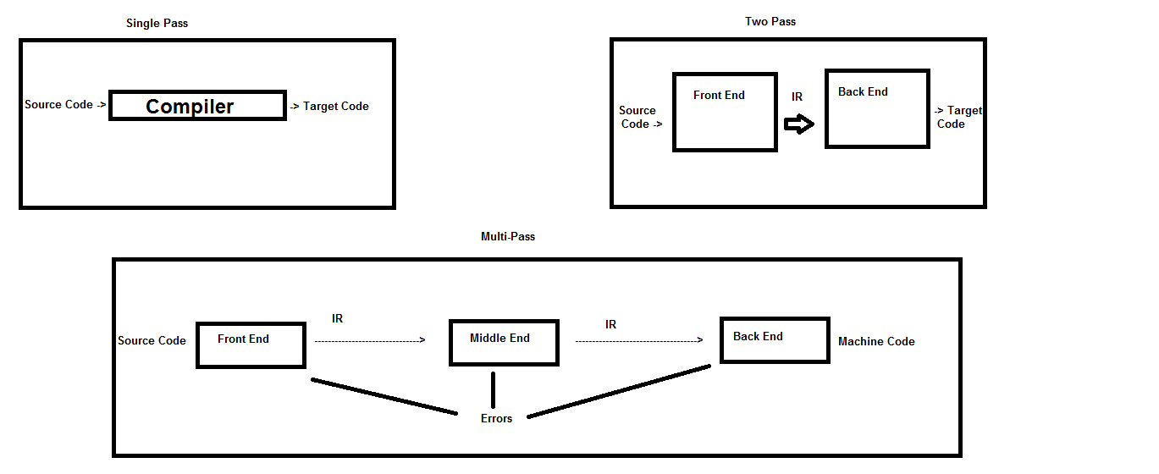
Pass Compilers In A Pic

Slide 8
Which One Better?
One pass compilers are faster
Multipass ensures the correctness of small program

Slide 9
Cross Compiler
Used to compiler source code for different kinds of platform
Used for cross platform software development of binary code
Bootstrapping to a new platform

Slide 10
Source to Source Compiler
Takes a source code of higher level language and outputs another higher level language
Also known as trans compiler
Translating the legacy of code to use
Automatic code refactoring is done

Slide 11
Just In Time Compiler
Last part of multi-pass compiler
Ahead of time compilation & interpretation is done
Form of dynamic compilation
Allows adaptive optimization
Example : java, . Net (CIL) system

Slide 12
Hardware Compiler
Also known as Silicon Compiler
A software system
It converts Hardware Description Language (Verilog) into logic

Slide 13


Slide 14


